Slide 1
Center for Patient Placement
Improving Safety through Excellence in Patient Access
Brian Laneau, MSN, RN
Clinical Nursing Director, Center for Patient Placement
Therese Hudson-Jinks, MSN, RN, NEA-BC
Chief Nursing Officer & Senior Vice President Patient Care Services

Slide 2
Regulatory Requirements
The Joint Commission
  Leadership Chapter
    LD.04.03.11: The hospital manages the flow of patients throughout the hospital.
    Rational: Managing the flow of patients throughout their care is essential to prevent overcrowding , which can undermine the timeliness of care and, ultimately, patient safety. Effective management of system-wide processes that support patient flow can minimize delays in the delivery of care.

Slide 3
Portals of Entry
Source of admissions/inpatient volume:
  Operating Room
  Procedural Labs
    Electrophysiology
    Cath Lab
    Interventional Radiology
  Ambulatory Clinics
  Emergency Department
  Referring Facility Transfers
  ED-to-ED Transfer requests

Slide 4
Challenges
Increasing inpatient census
High ED boarder times > 200 mins
OR Holds
Opportunities for enhanced communication between the following key areas and roles
  Case Management
  Hospitality
  ED
  OR
  Inpatient Care Areas
  Admitting
  Outside Facilities
  MDs and others

Slide 5
Access:
Our commitment to our patients & families, care team & affiliates
Efficient Access to Care for Patients in Need of Expert Care at Tufts Medical Center and Floating Hospital for Children
  Coordinated care 24/7 -- 365
  Data driven process
  Highly Reliable processes
    Right patient
    Right level of care
    Right time
    Cared for in the right “care team”

Slide 6
Consequences of ED Boarding
  Patient’s leave without being seen (LWBS)
    Weiss, S., Ernst, A., Derlet, R., King, R., Bair, A., Nick, T. (2005). Relationship between the National ED Overcrowding scale and the number of patients who leave without being seen in an academic ED. The American Journal of Emergency Medicine, 23(3), 288-294.
  Delays in care
    Horwitz, L.I., Green, J., Bradley, E.H. (2010). US Emergency department performance on wait time and length of visit. Annals of Emergency Medicine, 22(2), 133-141.
  Increase in medical errors
    Kulstad, E.B., Sikka, R., Sweis, R.T., Kelley, K.M., Rzechula, K.H. (2010). ED overcrowding is associated with an increased frequency of medication errors. American Journal of Emergency Medicine, 28(3), 304-309.
  Increase in overall length of stay
    Foley, M., Kifaieh, N., Mallon, W. (2011). Financial impact of emergency department crowding. The Western Journal of Emergency Medicine, 12(2), 192-197.
  Increase in mortality
    Singer, A.J., Thode Jr., H.C., Viccellio, P., Pines, J.M., (2011). The association between length of emergency department boarding and mortality. Academic Emergency Medicine, 18(12), 1324-1329.

Slide 7
Interventions
Structure: Creation of a communication and decision making hub- Center for patient placement
Process: Data driven process enhancements
  CPP
  ED

Slide 8
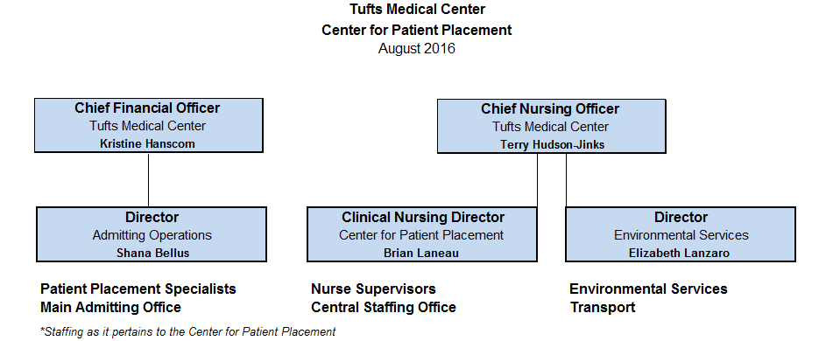
Team work across areas of influence

Slide 9
Structure: Center for Patient Placement
Patient
Hospitality
EasCare
Case Management
Nursing Supervisor
Admitting
Triage RN
Central Staffing

Slide 10
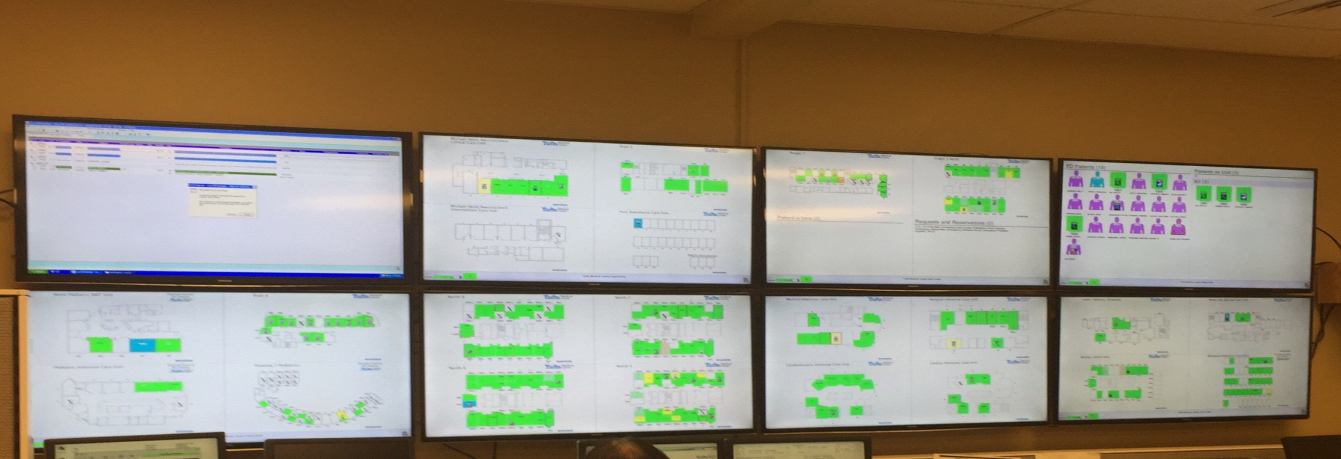
Systems
Visibility Tufts MC = RAPID VIEW
Room
And
Patient
Information
Display
Siemens RCO Invision – HIS
Cerner – Soarian Clinicals
Medhost – EDIS
FacilityFit (Transport and EVS)

Slide 11
    Process: A Day in The Life of the CPP
    Proactive Management vs. Reactive Decisions
  Weekly
  OR Schedule Forecasting
  Forecast Staffing
  Daily
  Hand-Off with CPP Nurse Supervisor (Night to Day Shift)
Daily Safety Huddle – Led by CNO, CEO
Bed Meeting
  CAPP Rounds (Communication and Patient Planning Rounds)
    Expected Day of Discharge
    Discharge ‘Appointment’
  End of Day Huddle (Current State Reconciliation for Discharges)
  Next Day Preview: Discharges, OR Volume, Scheduled Admissions, Etc.
  Nurse Supervisor Rounding

Slide 12
Process: Emergency Department
  Case Management Role
  Collaboration with Floors
    Clinical Leader Forum
    ED Boarder Committee
  Daily Processes
    A.M. Contact CPP for Availability of Med/ Surg Beds & ICU Beds
    Review of Current ED Volume & Staffing
    Recommendation for In-House Placement
    ED Observation Level of Care
  ED Volume Surge
    Priority Alert
    Code Help

Slide 13
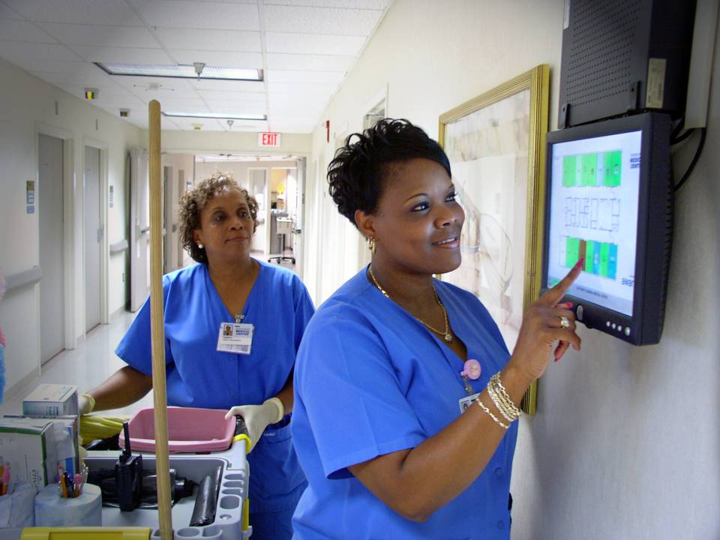
Role of EVS & Transport – Everyone is on the team

Slide 14
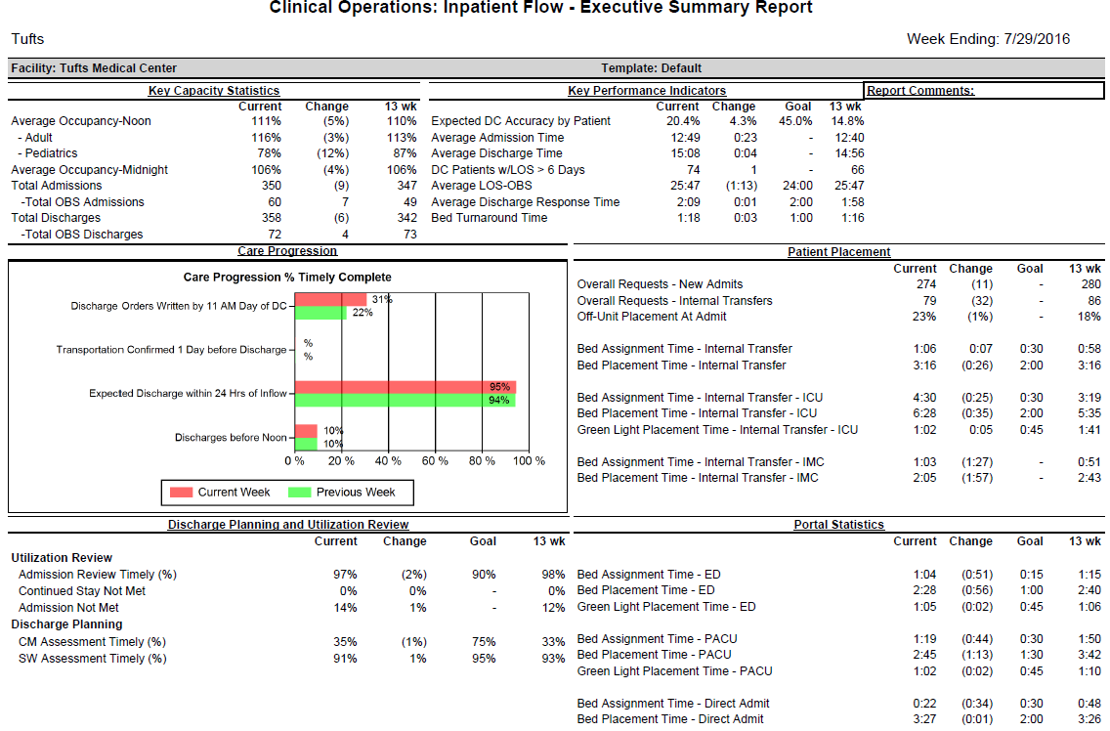
Reporting – Data Driven Processes
Monthly Patient Progression Meeting’s by Product Line; LOS Management
Reporting Available @ Facility, Product/ Service Line, Unit, & Patient Level
  Key Capacity Statistics
  Key Performance Indicators
  Care Progression Events
  Patient Placement Performance – Bed Request Process
  Discharge Planning & Utilization Review Metrics
  Resource Management – Bed Turnaround (EVS)

Slide 15
Results
Enhanced Operations while increasing volume
  ED Boarder Time reduced from > 200 mins to ~ 120mins
  Door to provider time reduced by 21% (34 mins)
  LWBS reduced by ~ 20% to < 2% (~ 1.7)
Near elimination of Code Help (1-2/year)
Enhanced communication
Near elimination of OR Holds

Slide 16
Emergency Department Visits and Admits

Slide 17
ED Boarder Time Relative to ADC

Slide 18
ED: LWBS Average per Month

Slide 19
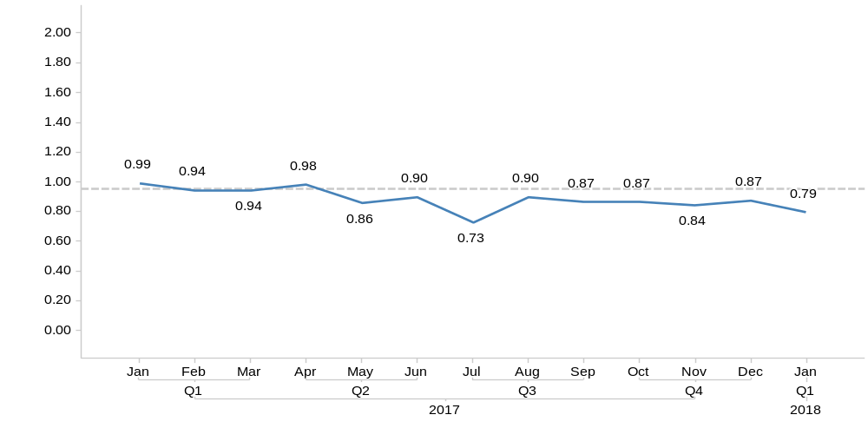
Overall LOS Index Trend – TuftsMC Overall
LOS Index ( < 1 is Better)
With Outliers

Slide 20
Commitment to Patient Safety
Safety huddle focus
Review of ED safety event reports
ED-Floor handoff process
Infection prevention and isolation precaution reports
Case management involvement on outside hospital transfers when clinically indicated

